Slide 1


Slide 2


"Customer Personality Analysis for Retail Domain
Leveraging Data for Accurate Predictions.
Name – Ajay Kumar Jha
Date – 15/09/2023

Slide 3
Customer Personality Analysis is a detailed analysis of a company’s ideal customers. It helps a business to better understand its customers and makes it easier for them to modify products according to the specific needs, behaviors and concerns of different types of customers.
Customer personality analysis helps a business to modify its product based on its target customers from different types of customer segments. For example, instead of spending money to market a new product to every customer in the company’s database, a company can analyze which customer segment is most likely to buy the product and then market the product only on that particular segment.
Now with modern Machine Learning and Deep Learning techniques it is possible to utilize the power of algorithms and statistics to understand and predict sales using historical data.

Slide 4
1.Business problem:
1.1 Objective:
The objective is to analyze the customer’s different personality affecting their purchases of products.
1.2 Challenges:
The primary challenge stems from the lack of additional information about the types of customers and how their specific background effects and influences their decision in purchases of products.

Slide 5
2. Dataset:
2.1 Data Fields:
Fields include:
Attributes
People
ID: Customer's unique identifier
Year_Birth: Customer's birth year
Education: Customer's education level
Marital_Status: Customer's marital status
Income: Customer's yearly household income
Kidhome: Number of children in customer's household
Teenhome: Number of teenagers in customer's household
Dt_Customer: Date of customer's enrollment with the company
Recency: Number of days since customer's last purchase
Complain: 1 if the customer complained in the last 2 years, 0 otherwise

Slide 6
Products
MntWines: Amount spent on wine in last 2 years
MntFruits: Amount spent on fruits in last 2 years
MntMeatProducts: Amount spent on meat in last 2 years
MntFishProducts: Amount spent on fish in last 2 years
MntSweetProducts: Amount spent on sweets in last 2 years
MntGoldProds: Amount spent on gold in last 2 years
Promotion
NumDealsPurchases: Number of purchases made with a discount
AcceptedCmp1: 1 if customer accepted the offer in the 1st campaign, 0 otherwise
AcceptedCmp2: 1 if customer accepted the offer in the 2nd campaign, 0 otherwise
AcceptedCmp3: 1 if customer accepted the offer in the 3rd campaign, 0 otherwise
AcceptedCmp4: 1 if customer accepted the offer in the 4th campaign, 0 otherwise
AcceptedCmp5: 1 if customer accepted the offer in the 5th campaign, 0 otherwise

Slide 7
Response: 1 if customer accepted the offer in the last campaign, 0 otherwise
Place
NumWebPurchases: Number of purchases made through the company’s website
NumCatalogPurchases: Number of purchases made using a catalogue
NumStorePurchases: Number of purchases made directly in stores
NumWebVisitsMonth: Number of visits to company’s website in the last month
3.Target
Need to perform clustering to summarize customer segments.
:

Slide 8
4. Approach/Flow of Solving the Biz Problem
There is multiple approach to solve the above stated problem, which are name as:
Data Loading and Analysing
Data Cleaning
Correlation /Linear Regression
Data Preprocessing
Principal component Analysis (PCA)
Dimensionality Reduction
Elbow Method
Clustering.

Slide 9
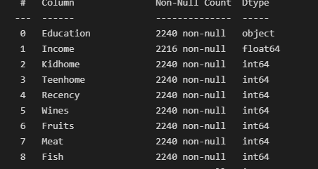
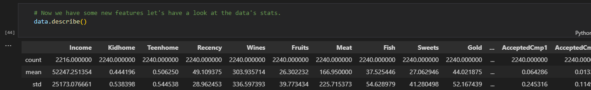
5. Detailed EDA(Exploratory Data Analysis)
5.1. Data understanding and insights:
we will start with the understanding of the data. First, we have analyzed the shape of the dataset.
Finding null values
Finding the mean value and median .

Slide 10
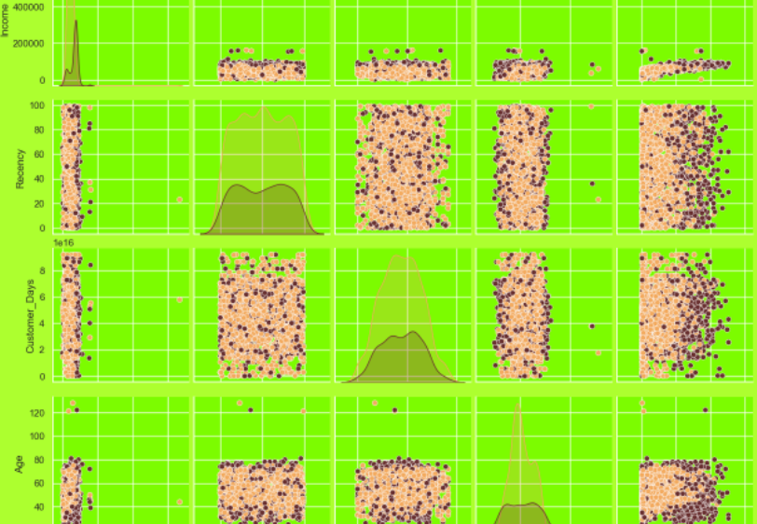
5.2. Visualization: We have plot different bar charts and histogram charts to visualize and analyse the dataset.

Slide 11
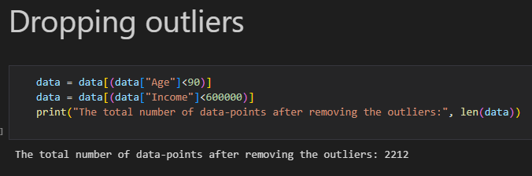
5.3. Outliers: From the visual analysis, we can observe that the 'total number of data-points after removing the outliers.

Slide 12
Modelling Approach
Dimensionality Reduction: In this problem, there are many factors on the basis of which the final classification will be done. These factors are basically attributes or features. The higher the number of features, the harder it is to work with it. Many of these features are correlated, and hence redundant. This is why I will be performing dimensionality reduction on the selected features before putting them through a classifier. Dimensionality reduction is the process of reducing the number of random variables under consideration, by obtaining a set of principal variables. Principal component analysis (PCA) is a technique for reducing the dimensionality of such datasets, increasing interpretability but at the same time minimizing information loss. Steps in this section : Dimensionality reduction with PCA Plotting the reduced data frame

Slide 13
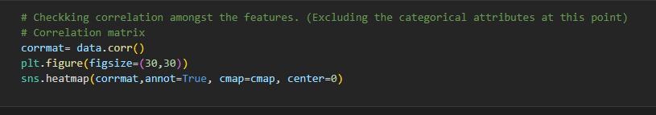
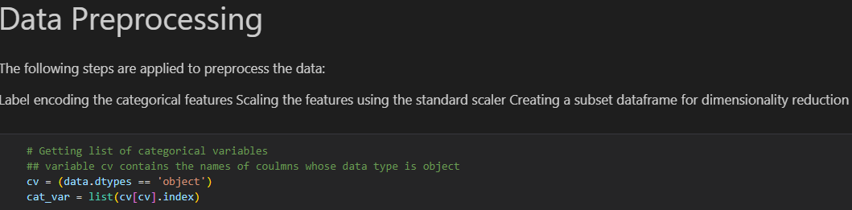
Model Name: Linear Regression /Correlation
Conclusion:
The Linear Regression model provides a reasonable but not exceptional fit to the data. There is room for further improvement or exploration of alternative models to enhance prediction accuracy.
Model Name: Data Preprocessing
Conclusion:
.

Slide 14
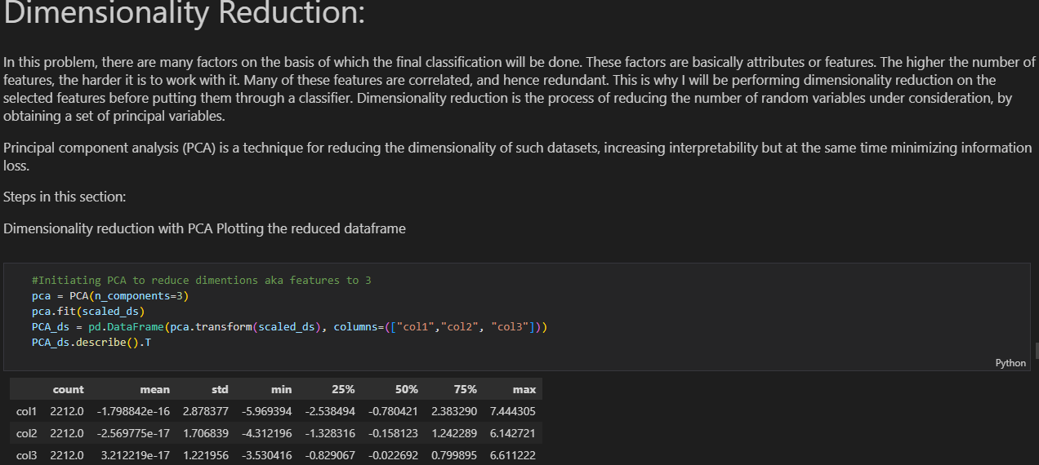
Model Name: Principal component Analysis (PCA)
Model Name:Dimensionality Reduction
Conclusion:

Slide 15
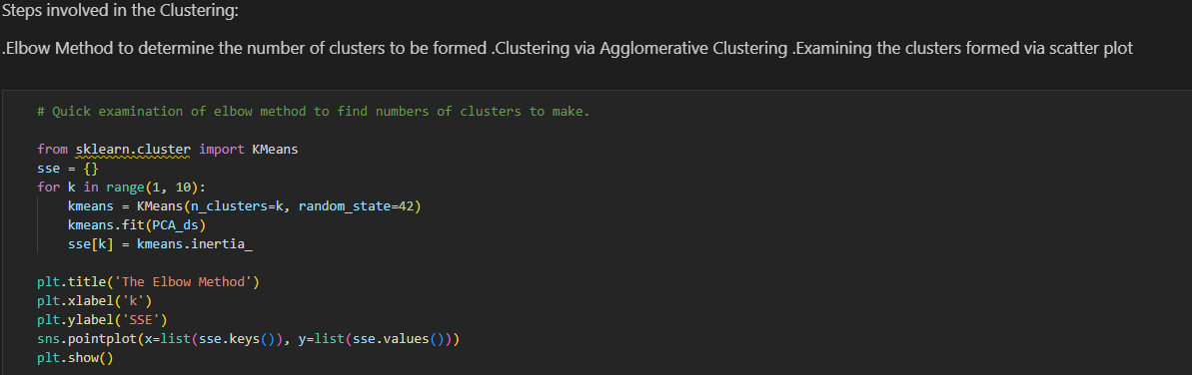

Model Name: Elbow Method
Conclusion:
Model Name: Clustering
Conclusion:

Slide 16
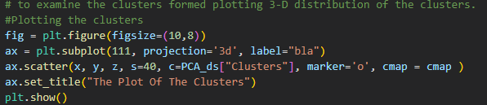
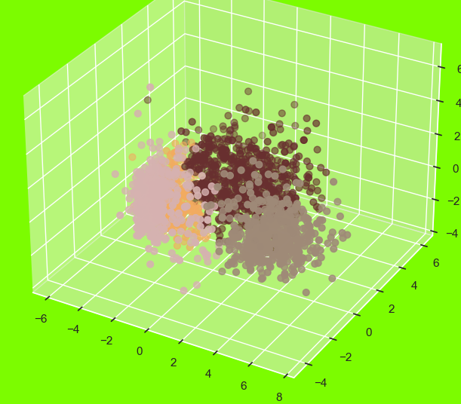

Slide 17
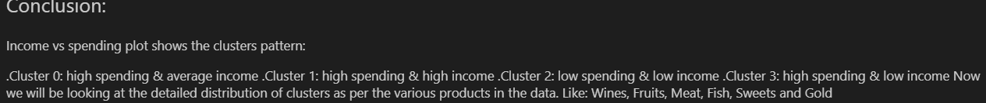
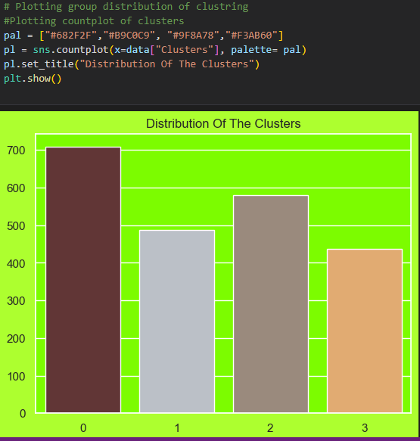

6. Final Model
Model Name: Conclusion:

Slide 18
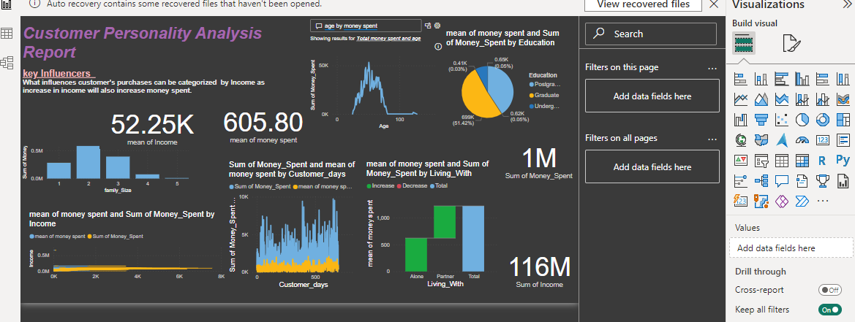
6 .Visualization in Power Bi

Slide 19
Thank you!!!

